Slide 1
Lesson 3-4 Text & Objects & Vector graphics

Slide 2
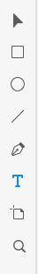
Adding text
In Adobe XD you can add text with two options:
One line text
Text area with multiple lines
To start adding text choose text tool
With text tool active click on top of design page to create one line text
Text tool

Slide 3
Adding text
Once you have clicked on design page enter some text like: ”FindMeCar”
Once you have typed text, use ”Select tool” to move text to center of the screen.
You can see while moving object that Adode XD helps you to place objects on some keyp points (like center of screen)

Slide 4
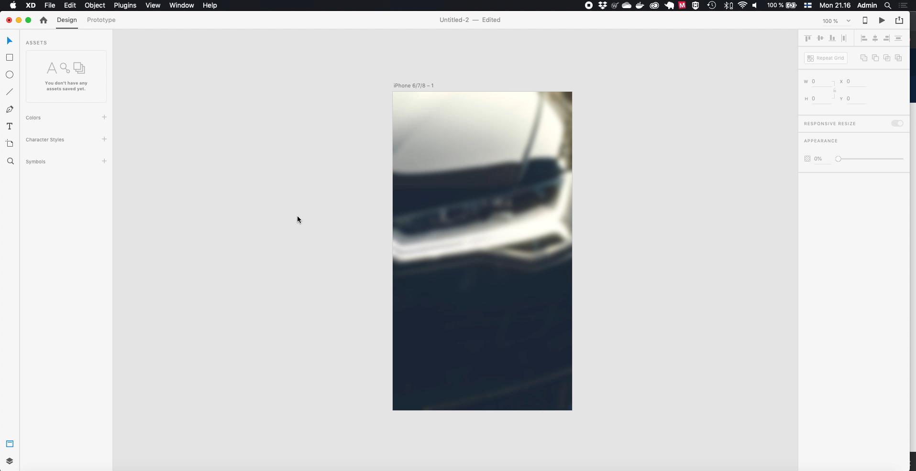

Slide 5
Object properties

Slide 6
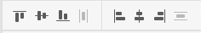
Alignment properties
On the right pane you can access object properties.
On top of the pane first properties affect to alignment
Alignment commands can be applied to any selected object or object groups
Align top
Align bottom
Align left
Align right
Center vertically
Center horizontically

Slide 7
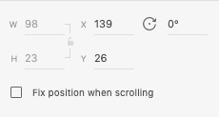
Position and rotation
Next property set is object position, size and rotation
On text objects its not possible to change width / height, but you can manually change position (X/Y) and its rotation
Width / height of object
Rotation of object
Position of object

Slide 8
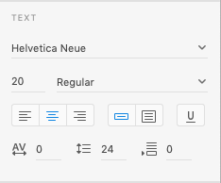
Text properties
On text objects, font size and other properties can be changed
Also character spacing, row height are adjustable.
Choose now ”Open Sans” as our font type, make it BOLD and size of 60

Slide 9


Slide 10
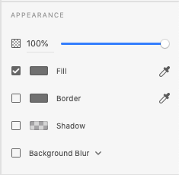
Appearance
Last properties that you can change are related to Appearance
First setting relates to opacity of objects.
Second on is fill color, or in text actual color of text. By clicking color on left of Fill text you can choose color
Or you can use eyedropper tool to select color from anywhere of screen
Third one is border color of object
Fourth one add shadow to object
And last one can be used to blur design behind selected object

Slide 11
Appearance
Lets use eyedropper tool to select color for our text, we can pick color from our background imge
Also lets add some shadow to text
And finally as text seems too large, we make size of 45

Slide 12
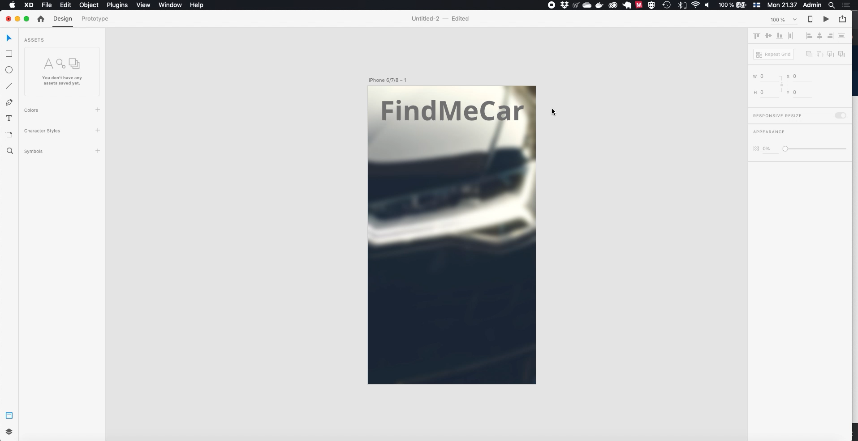

Slide 13
Making text area
Now we can add text area to below of our title text.
This can be made by choosing text tool and then pressing and dragging wanted area on our page.
Once area is ready, type some information to user
Then modify properties of text are by selecting it and choosing:
Font size 20
Font color white
Font type regular

Slide 14
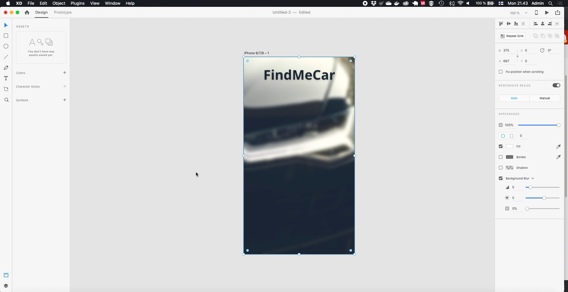

Slide 15
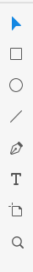
Adding vector objects
In Adobe XD there are four ways to draw vector objects
Rectangle
Circle
Line
Free form
These object have same properies (mostly), in this tutorial we use rectangle object as its most common.
Choose Rectangle tool for now
Rectangle
Circle
Line
Free form

Slide 16
Adding vector objects
To add rectangle object press and drag mouse on page design.
We are adding button for user, so let’s add it to the below of text area.
Then we make it’s fill color gray and disable border

Slide 17


Slide 18
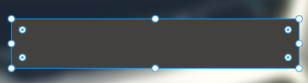
Modifying object
Once objects are placed on design page, you can modify their properties:
On corners we have circles which adjust size/position
On edges points modify width/height
On inner cornes points modify corner roundness
To modify properties click and drag points
Drag points to size object
Round corners of object

Slide 19
Modifying objects
Let’s modify our new object to have round cornes and adjust its size a bit.
If you want to keep object proportions (ratio) hold SHIFT-key while resizing object

Slide 20
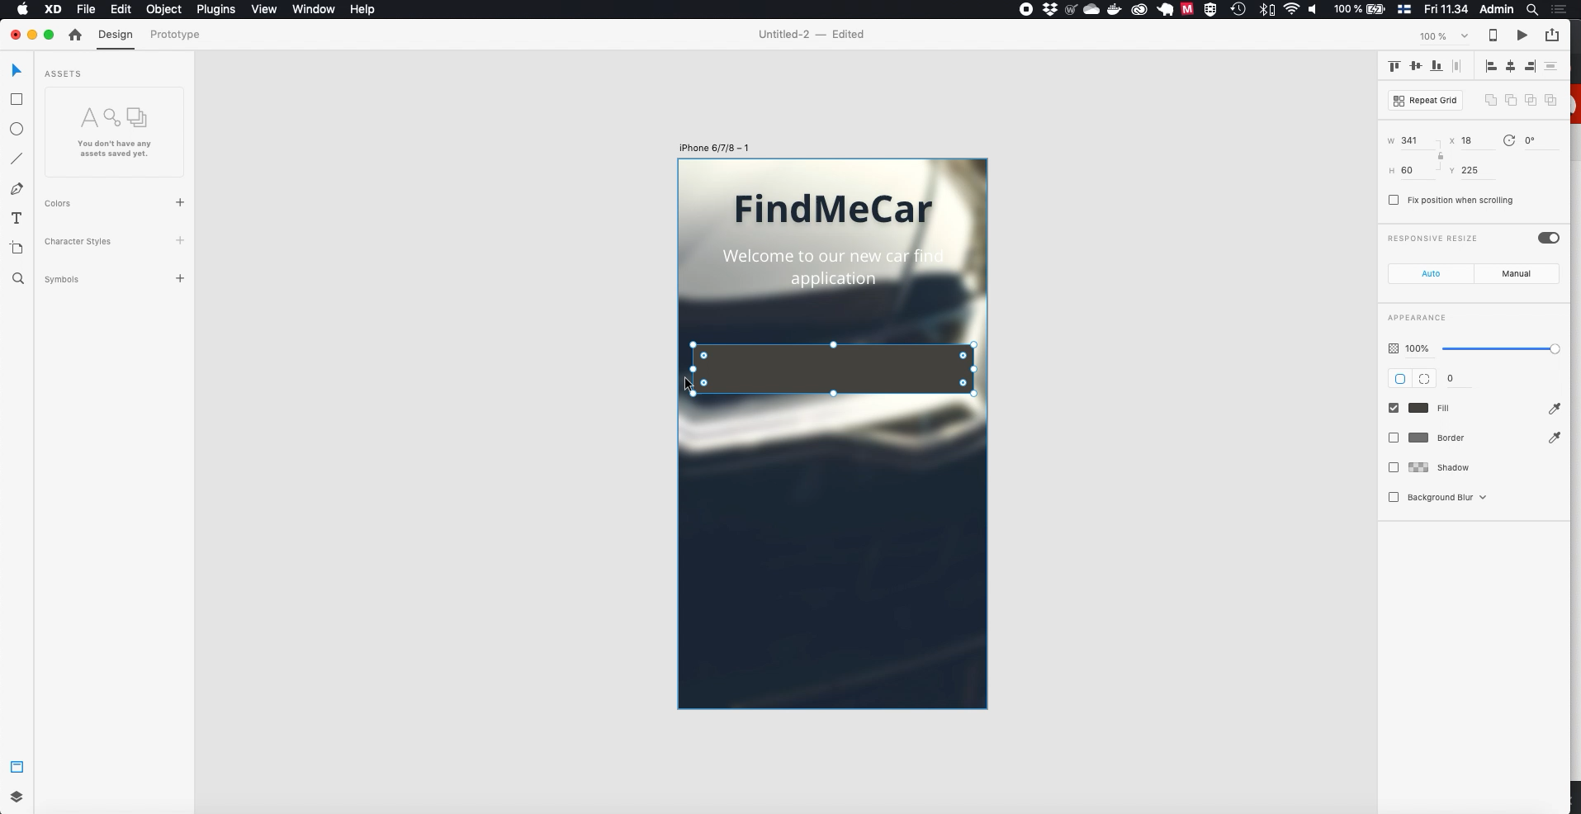
Modifying objects
Let’s modify our new object to have round cornes and adjust its size a bit

Slide 21
Copying objects
To copy objects, first select object and then choose ”Edit -> Copy” or use key command CTRL + C
Object can be pasted by ”Edit -> Paste” or key command CTRL + V
Pasted object is placed over original object, so you need to move it to new location

Slide 22
Moving objects
To move object click and drag some where in the object (not on points)
If you want to move object only horizontially / vertically hold SHIFT-key while draggin object
Now we are ready to create three buttons:
Copy-paste our button
Then move pasted object vertically

Slide 23
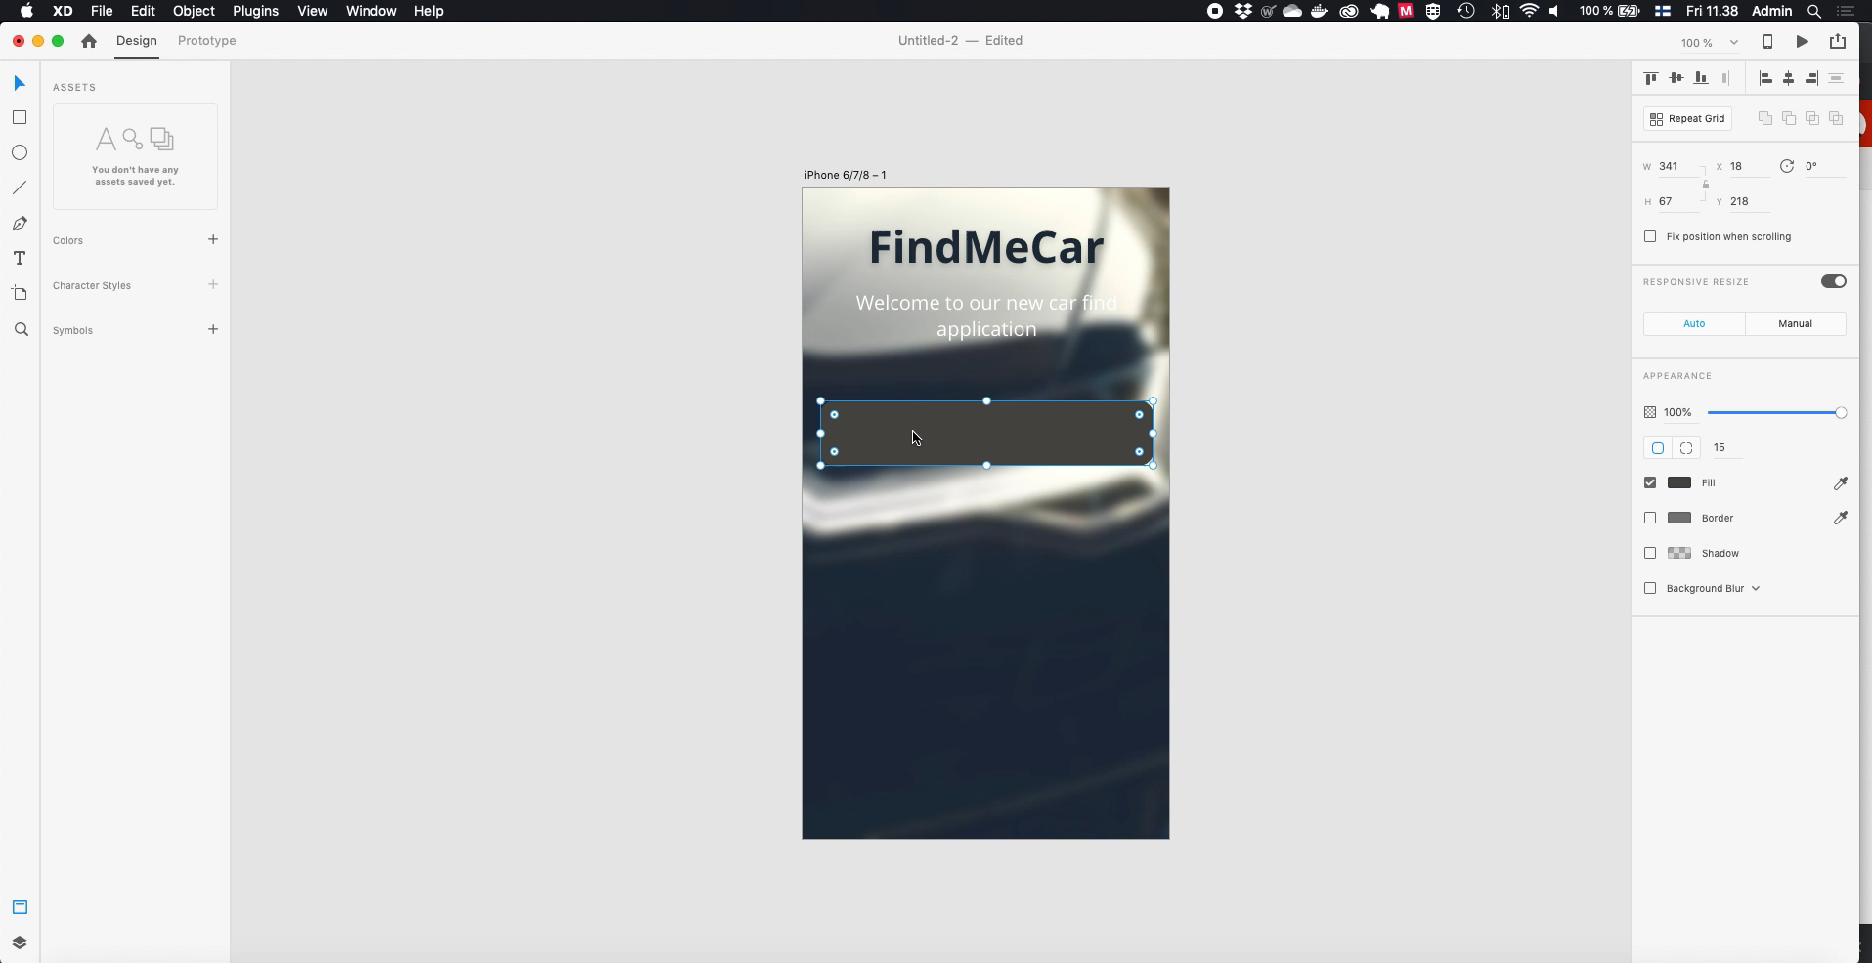
Moving objects
To move object click and drag some where in the object (not on points)
If you want to move object only horizontially / vertically hold SHIFT-key while draggin object
Now we are ready to create three buttons:
Copy-paste our button
Then move pasted object vertically

Slide 24
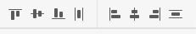
Moving objects
Once objects have been moved we can make sure they are distributed equally in vertical direction. This can be done with button:
Now choose all our buttons with clicking them by holding SHIFT-key, then press distribute vertically button.

Slide 25
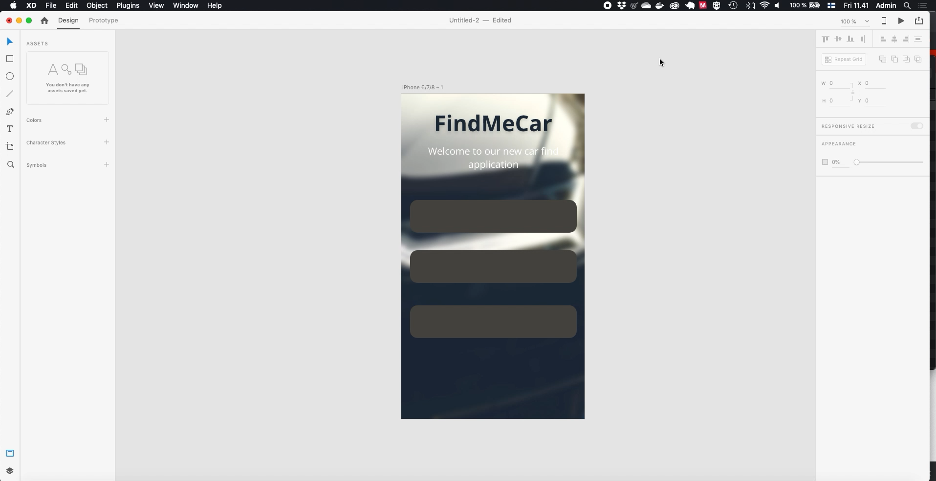
Moving objects
Once objects have been moved we can make sure they are distributed equally in vertical direction. This can be done with button:
Now choose all our buttons with clicking them by holding SHIFT-key, then press distribute vertically button.

Slide 26
Locking / unlocking objects
It’s possible to lock object to prevent accidentially changing them.
This can be done by right-clicking object and choosing Lock/Unlock or from ”Edit -> Lock/Unlock”

Slide 27
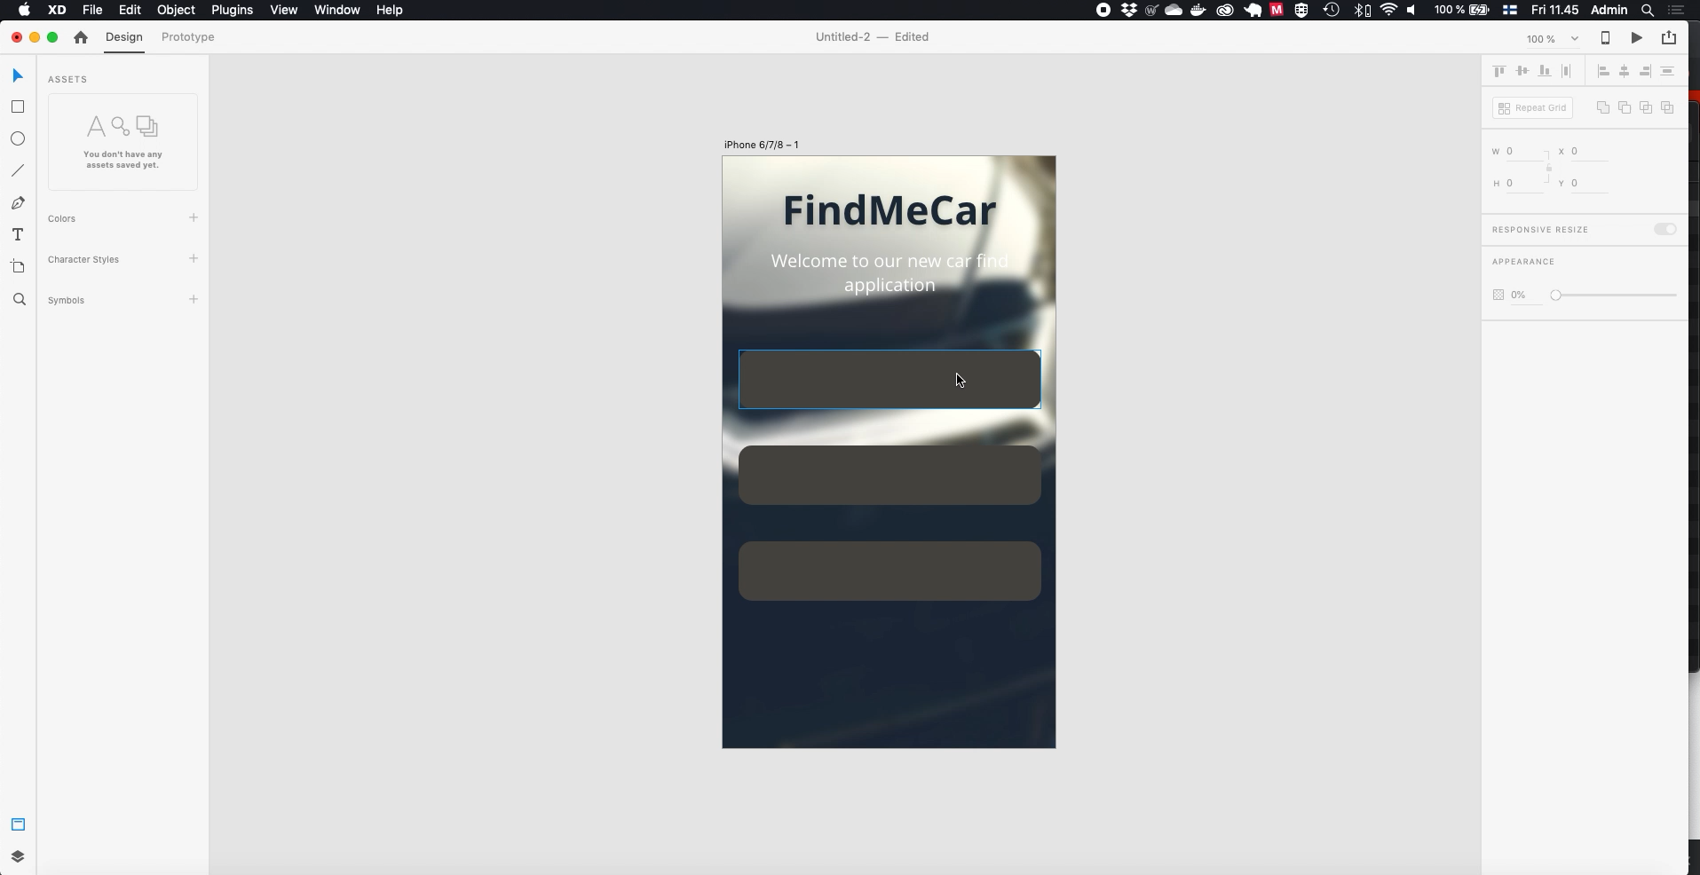
Locking / unlocking objects
It’s possible to lock object to prevent accidentially changing them.
This can be done by right-clicking object and choosing Lock/Unlock or from ”Edit -> Lock/Unlock”

Slide 28
Adding text / graphics to buttons
Now as we have our buttons ready, we can modify buttons to have text and graphics.
Choose text tool and type titles to buttons
First button to have text ”Cars near me”
Second button to have text ”Latest cars”
Third button to have text ”My profile”

Slide 29


Slide 30
Adding text / graphics to buttons
Once you have added text, drag texts to center of each button

Slide 31
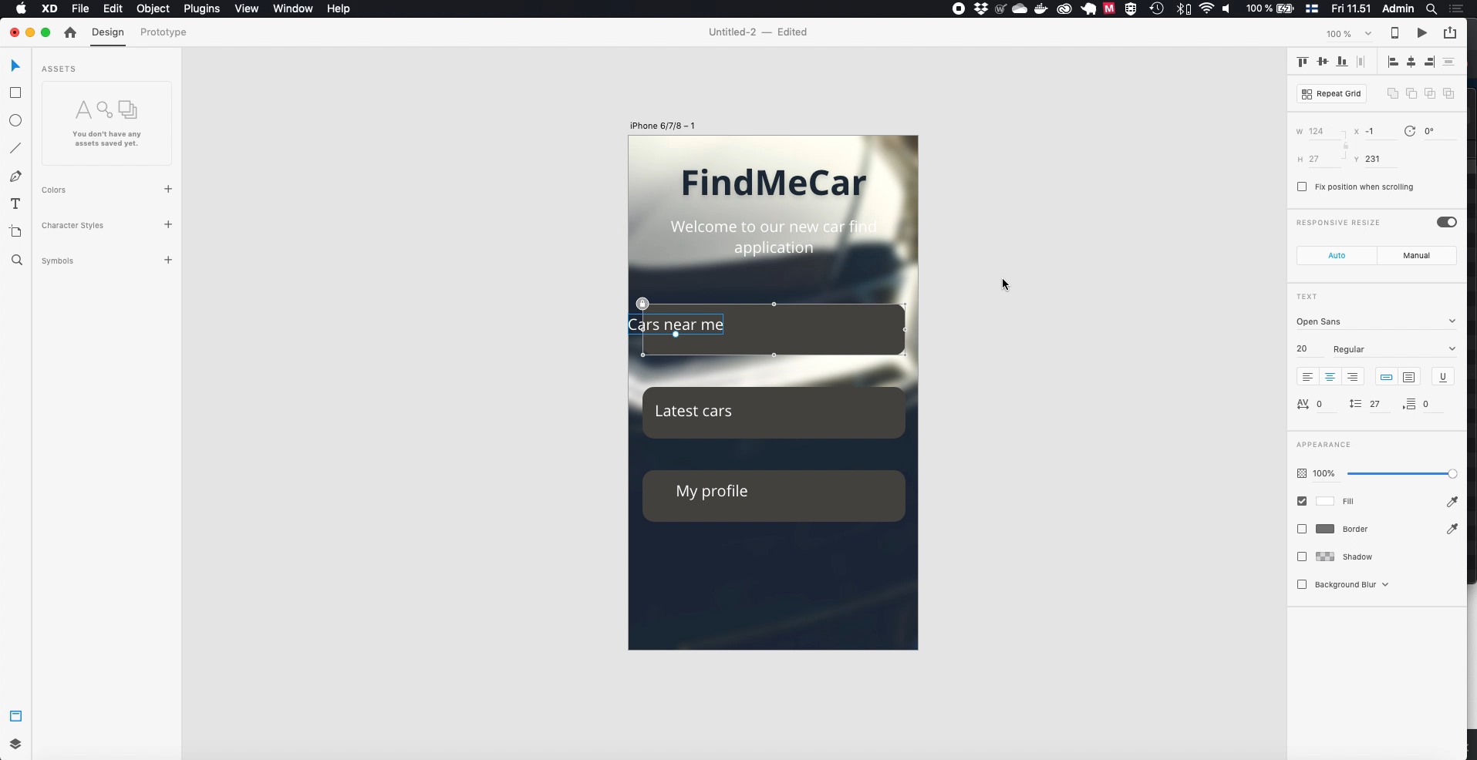

Slide 32
Adding text / graphics to buttons
Next import icons from our material folder, choose images:
man-user.svg
maps-and-flags.svg
money-bag-with-dollar-symbol.svg
These images are SVG-graphics, so they are vectors and can be modified in Adobe XD.
You can find roaylty-free SVG-graphics for example from flaticon.com, but if don’t buy license you need to give credit to author if so required.

Slide 33


Slide 34
Adding text / graphics to buttons
Imported images are way too large now, we need to resize them and place them onto buttons.
REMEMBER: If you want to keep object proportions (ratio) hold SHIFT-key while resizing object

Slide 35
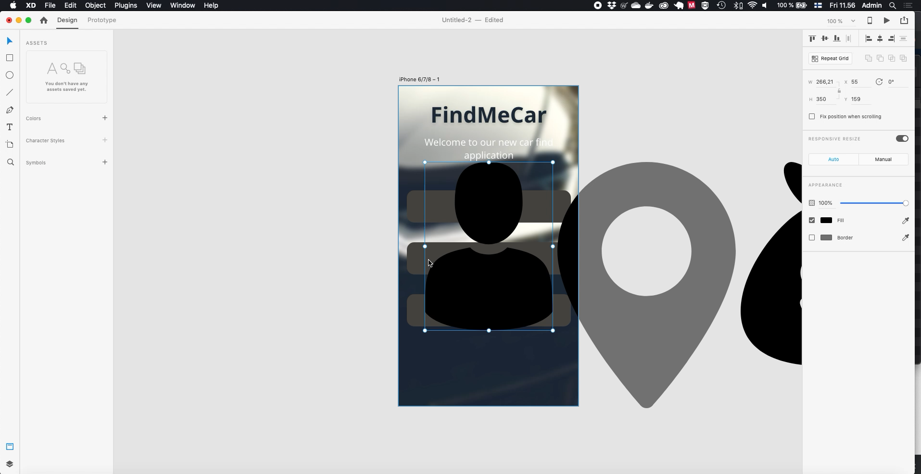

Slide 36
Adding text / graphics to buttons
As mentioned before SVG-graphics properties can be changes, now choose all of our graphics and make them to have fill color white

Slide 37


Slide 38
Adding text / graphics to buttons
Ok, our buttons are now ready
As each of our button contains three object, button itself, text and graphics. We can group these objects to be as one object. This way it’s easier to move these objects as one.
To group items we first need to unlock our button
Then we choose objects we want to group and chosee ”Edit -> Group”
We can also tighten spacing a bit

Slide 39


Slide 40
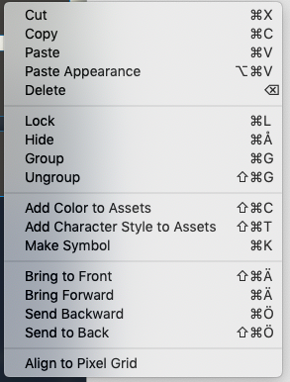
Arranging object in Z-direction
Each object is placed in its own Z-index, we means that some object are in behind or front of other object.
This arrangement can be changed by selecting object and right-clicking object (or clicking object while CTRL button holded)

Slide 41
Finalising our first page
On next video we will finalise our first page so that we can move on to second page.
You can follow video, or use your own design to make page have advertisement on bottom of page.
TIP: to modify image once it has been masked, double-click masked area

Slide 42
